Slide 1
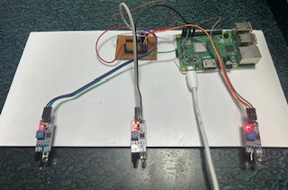
HAND GESTURE RECOGNITION AND VOICE CONVERSION SYSTEM FOR DUMB PEOPLE
TEAM MEMBERS :
Hemavarni.S
Hema Chandrika.D
Jeevitha.P
Karishma .S

Slide 2
Introduction
For any form of communication to be effective it must operate efficiently for both informant and the recipient.
If a speaker or signer has a limited vocabulary, or if someone cannot understand or even access the fluent signs or words they express the interaction of the two has little to no value.
Using hand gesture recognition with IR sensors converted to voice output is for individuals with speech and hearing impairments.

Slide 3
ALGORITHM
Data Collection
Preprocessing
Training
    Train a machine learning model on preprocessed data
    Load preprocessed data
    Split data into training and testing sets
    Choose a machine learning algorithm (e.g., SVM, Random Forest, Neural Network)
    Train the model on the training data
    Evaluate the model's performance on the testing data

Slide 4
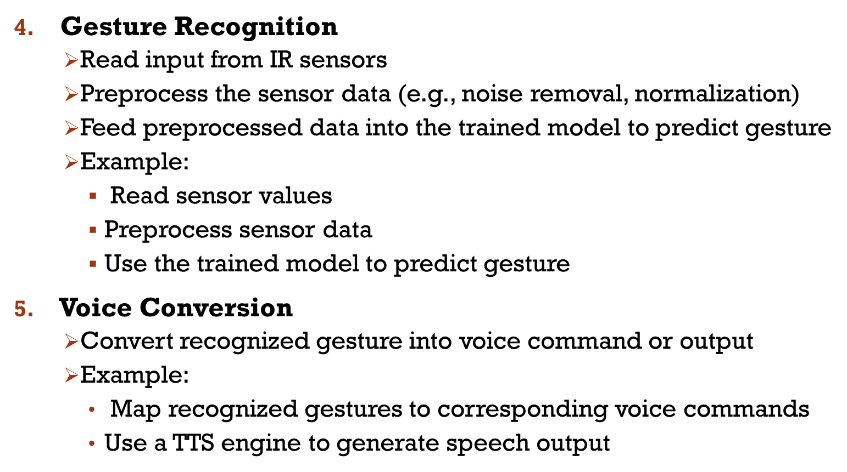

Slide 5
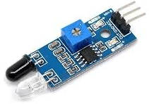
PROPOSED SOLUTION
IR Sensor Selection:
  Choose IR sensors suitable for detecting hand gestures. IR proximity sensors or IR reflective sensors can work well.
  Ensure compatibility with Raspberry Pi GPIO pins and power requirements.
  IR sensors are placed in strategic positions to cover the area where hand gestures will be performed. These sensors emit infrared light and detect its reflection or absence when obstructed by an object, such as a hand.
  The entire process from IR emission to gesture recognition and feedback occurs in real-time, enabling interactive applications where users can control devices or interfaces through hand gestures.

Slide 6
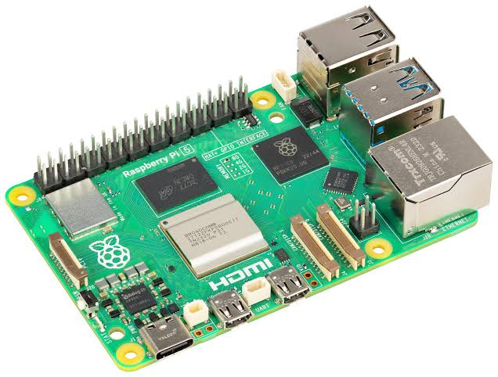
Hardware Setup:
  Connect IR sensors to the GPIO pins of the Raspberry Pi.
  Provide appropriate power to the sensors and Raspberry Pi.
  Consider using a breadboard for prototyping and connecting multiple sensors.
Software Development:
  Set up the Raspberry Pi with an operating system, here we used LINUX OS.
  Write code to read data from the IR sensors through GPIO pins using Python programming language.
  Implement signal processing techniques to detect hand gestures based on changes in IR sensor readings.
  Use libraries like RPi. GPIO for GPIO control and sensor interfacing.

Slide 7
Feedback Mechanism:
  Provide feedback to the user based on recognized gestures.
  Options for feedback include:
  Visual feedback: Use LEDs connected to GPIO pins to indicate recognized gestures.
  Auditory feedback: Play sounds or speech output using the Raspberry Pi's audio output.
  Haptic feedback: Interface with vibration motors or other tactile feedback devices for physical feedback.
  Integrate feedback mechanisms into the software based on gesture recognition results.

Slide 8
Work flow
Start : Hand Sensing/Recognition by IR Sensor
Initailize : Configure the raspberry Pi GPIO pins
Detect IR Signal
Wait For User Input
ACTIVE VOICE OUTPUT: Trigger voice output , convert message to speech
Python Program Processing

Slide 9
THANK you

